Slide 1
Introduction
Problems
Method
Exposure bias
Overcorrection
Selects oracle words from its predicted words and then samples as context from the oracle words and ground truth words
The oracle words are selected not only with a word by-word greedy search but also with a sentence level evaluation, BLEU

Slide 2
Reference:
Training
comply
with
the rule
Minimizing cross-entropy of each component
comply
with
the rule
abide
by
the law
: condition
comply
with

Slide 3
Mismatch between Train and Test
Test
abide
with
the rule
We do not know the reference
abide
with
the rule
Testing: The inputs are the outputs of the last time step.
comply
by
the law
Exposure bias
abide
with
Notes:
Exposure Bias
暴露；暴曬

Slide 4
Teacher- forcing
Test
abide
by
the law
We do not know the reference
abide
by
the law
Testing: The inputs are the outputs of the last time step.
comply
with
the rule
Overcorrection
abide
by
Notes:
Exposure Bias
暴露；暴曬

Slide 5
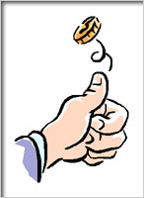
Scheduled Sampling
A
A
A
B
B
B
From oracle words
From oracle words
From reference
From reference

Slide 6
Beam Search
Keep several best path at each step
Beam size = 2
A
B
A
B
A
A
B
B
A
B
A
B
A
B

Slide 7
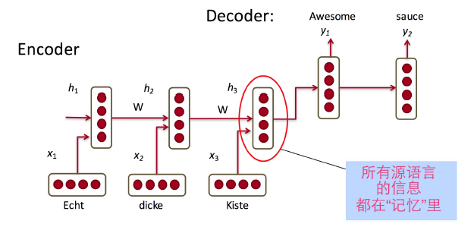
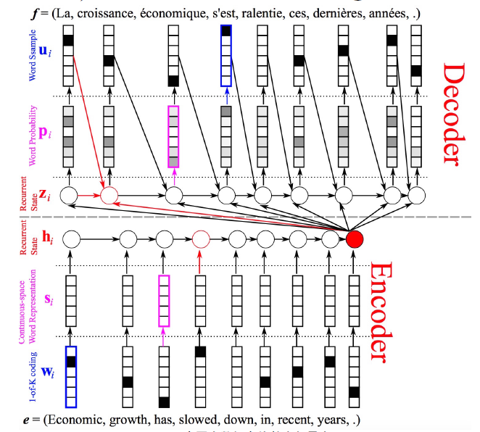
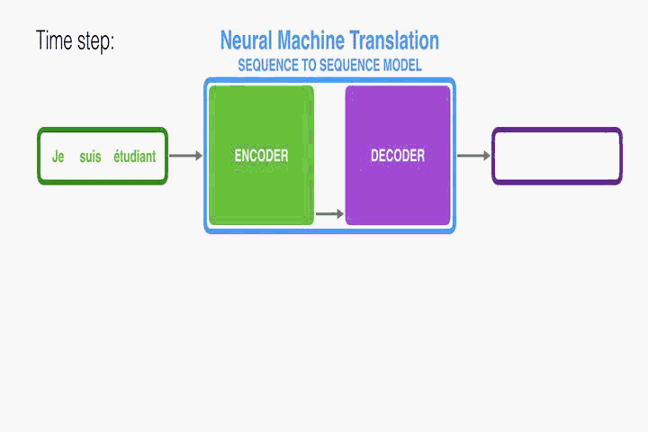

Slide 8
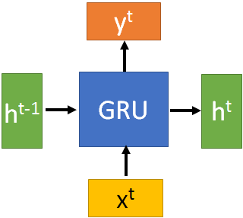
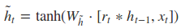
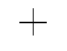




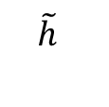
GRU
y^{t}
h^{t-1}
$$⨀$$
$$＋$$
h^{t}
$$⨀$$
1-
$$⨀$$
reset
update
r
z
$$\tilde{h}$$
h^{t-1}
x^{t}
x^{t}
Notes:
It combines the forget and input gates into a single “update gate.” It also merges the cell state and hidden state, and makes some other changes.
The update gate in GRU is corresponding to the forget gate in LSTM.
In GRU, reset gate does not control the amount of the candidate hidden state independently, it shares some information of update gate and thus has access to important temporal information for phoneme segmentation\cite{chung2014empirical}.

Slide 9
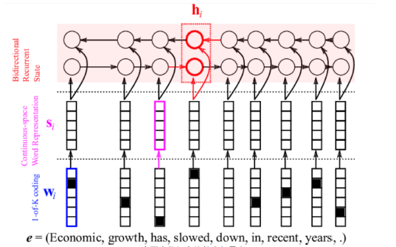
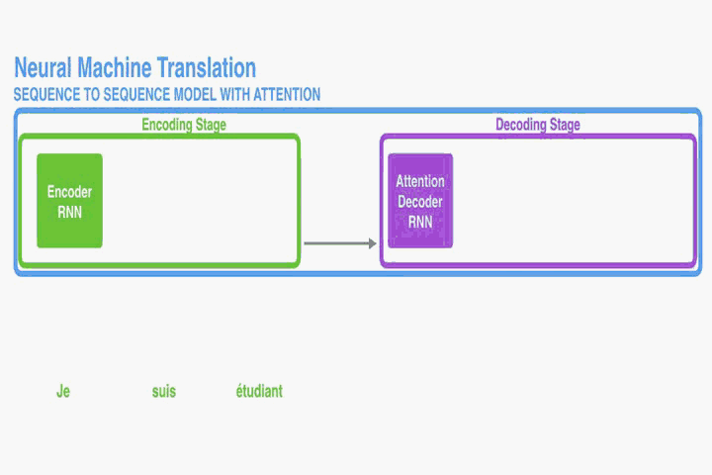
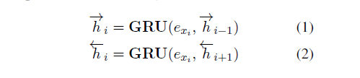
Encoder

Slide 10
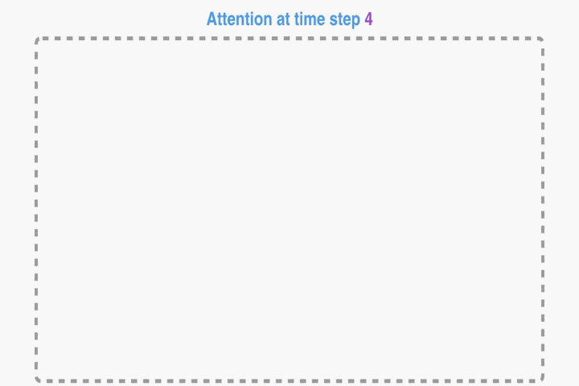
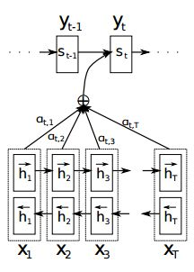
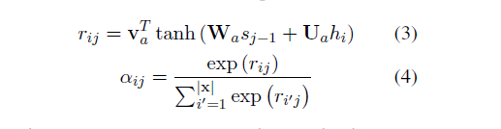

Attention

Slide 11
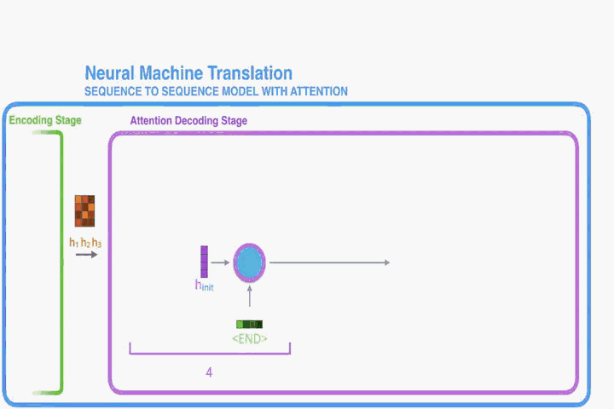
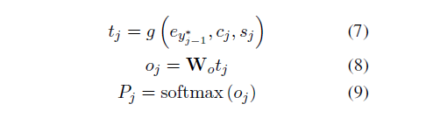
Decoder

Slide 13
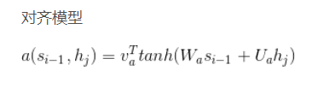
交叉熵损失函数
相关资料
Neural Machine Translation by Jointly Learning to Align and Translate
L=−[ylogyˆ+(1−y)log(1−yˆ)]

Slide 14
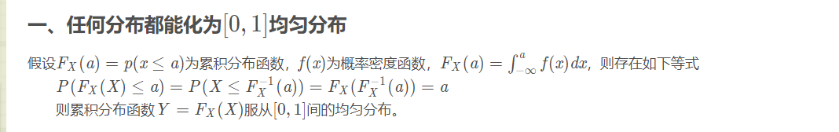
Bleu ：https://blog.csdn.net/allocator/article/details/79657792
gumbel：https://www.cnblogs.com/initial-h/p/9468974.html

Slide 15
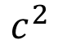
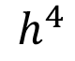
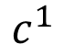
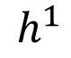
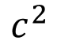
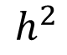
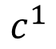
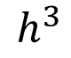
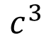
Dynamic Conditional Generation
$$c^{1}$$
$$c^{2}$$
machine
learning
. (period)
$$h^{1}$$
$$h^{2}$$
$$h^{3}$$
$$h^{4}$$
機
器
學
習
$$c^{1}$$
$$c^{2}$$
$$c^{3}$$
Encoder
Decoder
Notes:
Video caption is the same

Slide 16
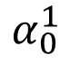
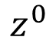
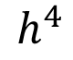
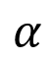
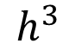
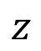
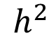
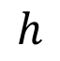
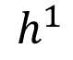
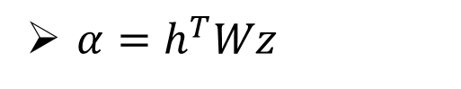
Machine Translation
$$α$$
Jointly learned with other part of the network
match
Attention-based model
$$h$$
$$z$$
$$α_{0}^{1}$$
match
What is ?
match
$$z^{0}$$
Design by yourself
Cosine similarity of z and h
$$h^{1}$$
$$h^{2}$$
$$h^{3}$$
$$h^{4}$$
Small NN whose input is z and h, output a scalar
機
器
學
習
$α=h^{T}Wz$
Notes:
Word vector

Slide 17
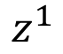
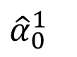
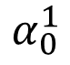
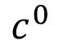
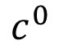
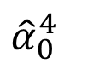
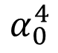
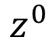
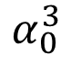
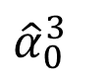
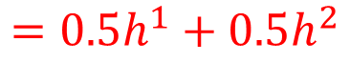
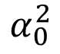
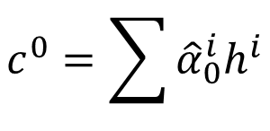

Machine Translation
Attention-based model
machine
$$c^{0}$$
0.5
$${\hat{α}}_{0}^{1}$$
0.5
$${\hat{α}}_{0}^{2}$$
0.0
$${\hat{α}}_{0}^{3}$$
0.0
$${\hat{α}}_{0}^{4}$$
$$z^{0}$$
$$z^{1}$$
softmax
$$α_{0}^{1}$$
$$α_{0}^{2}$$
$$α_{0}^{3}$$
$$α_{0}^{4}$$
$$c^{0}$$
Decoder input
$$h^{1}$$
$$h^{2}$$
$$h^{3}$$
$$h^{4}$$
$$c^{0}=\sum{{\hat{α}}_{0}^{i}h^{i}}$$
機
器
學
習
$$=0.5h^{1}+0.5h^{2}$$
Notes:
Word vector

Slide 18

Machine Translation
Attention-based model
machine
$$α_{1}^{1}$$
match
$$z^{0}$$
$$z^{1}$$
$$c^{0}$$
$$h^{1}$$
$$h^{2}$$
$$h^{3}$$
$$h^{4}$$
機
器
學
習
Notes:
Word vector

Slide 19













Machine Translation
Attention-based model
machine
learning
$$c^{1}$$
0.0
$${\hat{α}}_{1}^{1}$$
0.0
$${\hat{α}}_{1}^{2}$$
0.5
$${\hat{α}}_{1}^{3}$$
0.5
$${\hat{α}}_{1}^{4}$$
$$z^{0}$$
$$z^{1}$$
$$z^{2}$$
softmax
$$α_{1}^{1}$$
$$α_{1}^{2}$$
$$α_{1}^{3}$$
$$α_{1}^{4}$$
$$c^{0}$$
$$c^{1}$$
$$h^{1}$$
$$h^{2}$$
$$h^{3}$$
$$h^{4}$$
$$c^{1}=\sum{{\hat{α}}_{1}^{i}h^{i}}$$
機
器
學
習
$$=0.5h^{3}+0.5h^{4}$$
Notes:
Word vector

Slide 20

Machine Translation
Attention-based model
machine
learning
……
$$α_{2}^{1}$$
……
match
$$z^{0}$$
$$z^{1}$$
$$z^{2}$$
$$c^{0}$$
$$c^{1}$$
……
$$h^{1}$$
$$h^{2}$$
$$h^{3}$$
$$h^{4}$$
The same process repeat until generating
機
器
學
習
<EOS>
Notes:
Word vector

Slide 21


Slide 22

Modifying Training Process?
Reference
When we try to decrease the loss for both steps 1 and 2 …..
A
B
B
B
A
A
A
A
A
Training is matched to testing.
B
B
B
In practice, it is hard to train in this way.
A
A
B

Slide 23
LSTM
y^{t}
LSTM
c^{t}
y^{t}
c^{t-1}
Naive
h^{t}
h^{t}
h^{t-1}
h^{t-1}
x^{t}
x^{t}
c changes slowly
c^{t} is c^{t-1} added by something
h changes faster
h^{t} and h^{t-1} can be very different

Slide 24





x^{t}
z
W
$$=tanh\left( \right)$$
h^{t-1}
c^{t-1}
x^{t}
z^{i}
W^{i}
$$=σ\left( \right)$$
h^{t-1}
Input
gate
x^{t}
z^{f}
W^{f}
$$=σ\left( \right)$$
h^{t-1}
z^{f}
z^{i}
z
zº
forget
gate
x^{t}
zº
Wº
$$=σ\left( \right)$$
h^{t-1}
x^{t}
h^{t-1}
output
gate
Notes:
Identiy
C is vector

Slide 25

x^{t}
z
W
h^{t-1}
$$=tanh\left( \right)$$
c^{t-1}
c^{t-1}
diagonal
“peephole”
zº
z^{f}
z^{i}
obtained by the same way
z^{f}
z^{i}
z
zº
h^{t-1}
x^{t}
Notes:
Identiy
C is vector

Slide 26








y^{t}
c^{t-1}
c^{t}
$$⨀$$
$$＋$$
$$⨀$$
$$c^{t}=z^{f}⨀c^{t−1}$$
$$+z^{i}⨀z$$
$$⨀$$
$$h^{t}=z^{o}⨀tanh\left(c^{t}\right)$$
z^{f}
z^{i}
z
zº
$$y^{t}=σ\left(W^{′}h^{t}\right)$$
h^{t-1}
x^{t}
h^{t}
Notes:
Identiy
C is vector

Slide 27








LSTM
y^{t}
y^{t+1}
c^{t-1}
c^{t}
c^{t+1}
$$⨀$$
$$＋$$
$$⨀$$
$$⨀$$
$$＋$$
$$⨀$$
$$⨀$$
$$⨀$$
z^{f}
z^{i}
z
zº
z^{f}
z^{i}
z
zº
h^{t+1}
h^{t-1}
x^{t}
h^{t}
x^{t+1}
Notes:
https://arxiv.org/pdf/1412.3555.pdf
Identiy
C is vector

